Slide 1


Experiences with Insects
in Turfgrass
Norm Leppla, Director
UF/IFAS Statewide IPM Program

Slide 2
Turfgrass Field Day Topics
My personal war with chinch bugs
in Saint Augustinegrass
Status of mole cricket IPM and biological control
General principles of IPM
Sources of IPM information

Slide 3
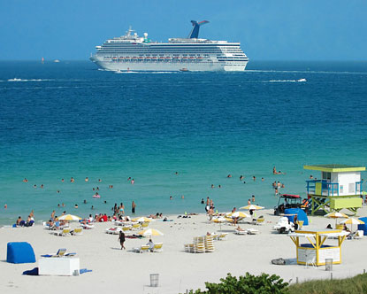
Water
Fertilizer
Insecticides
Mowing
Aeration
Monitoring
Replacement

Slide 4
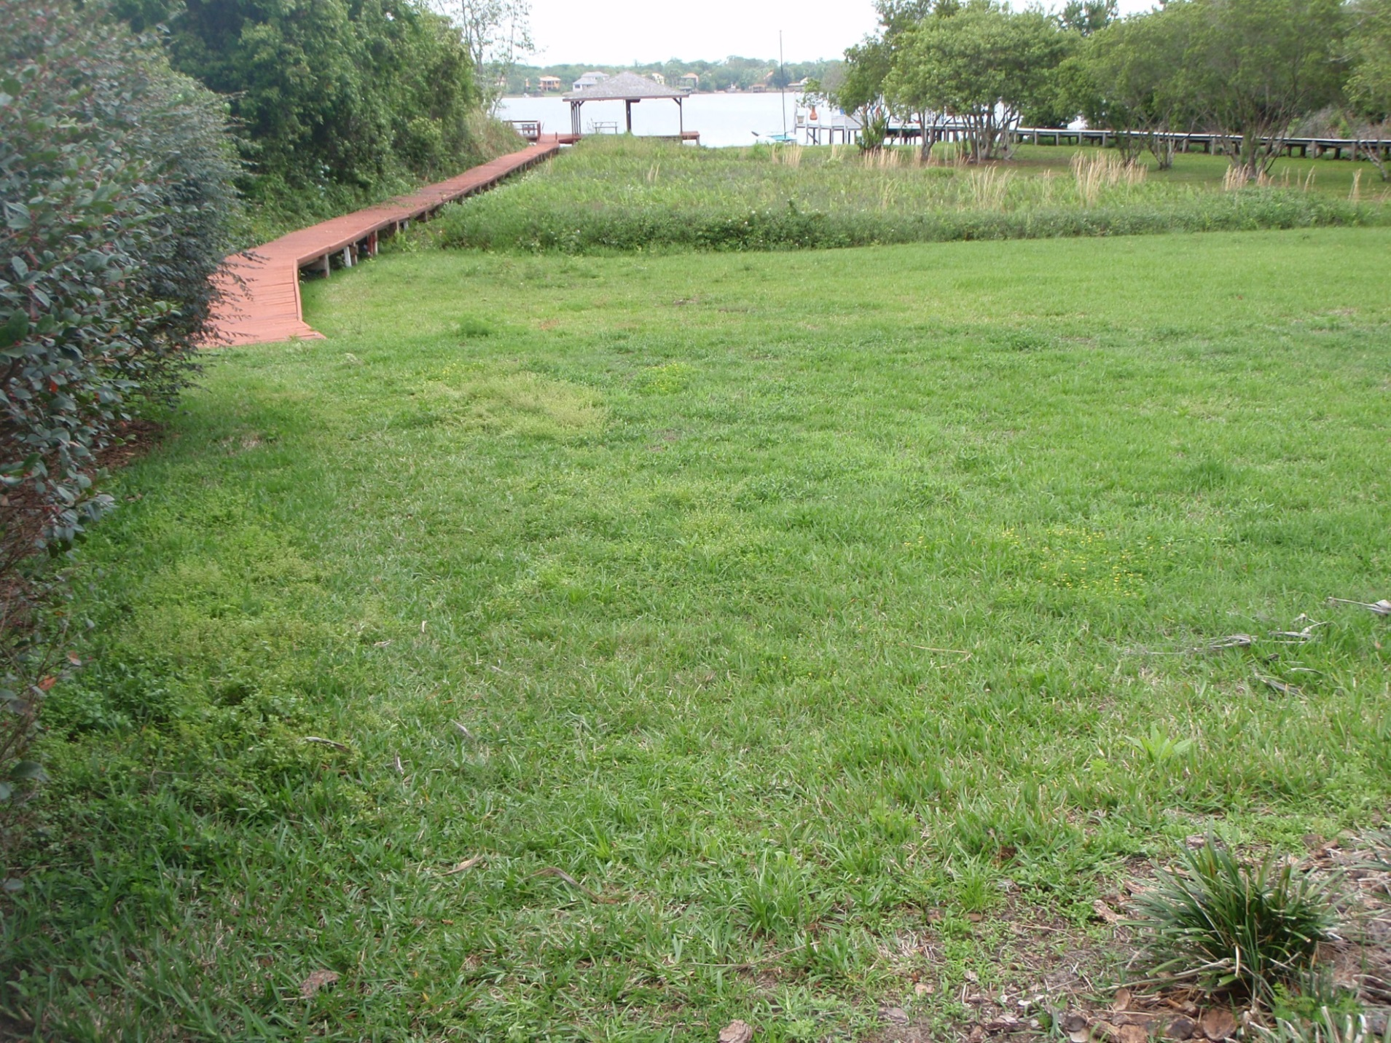
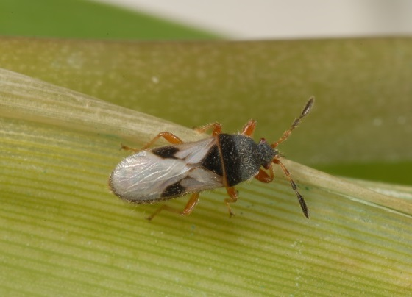

Slide 5
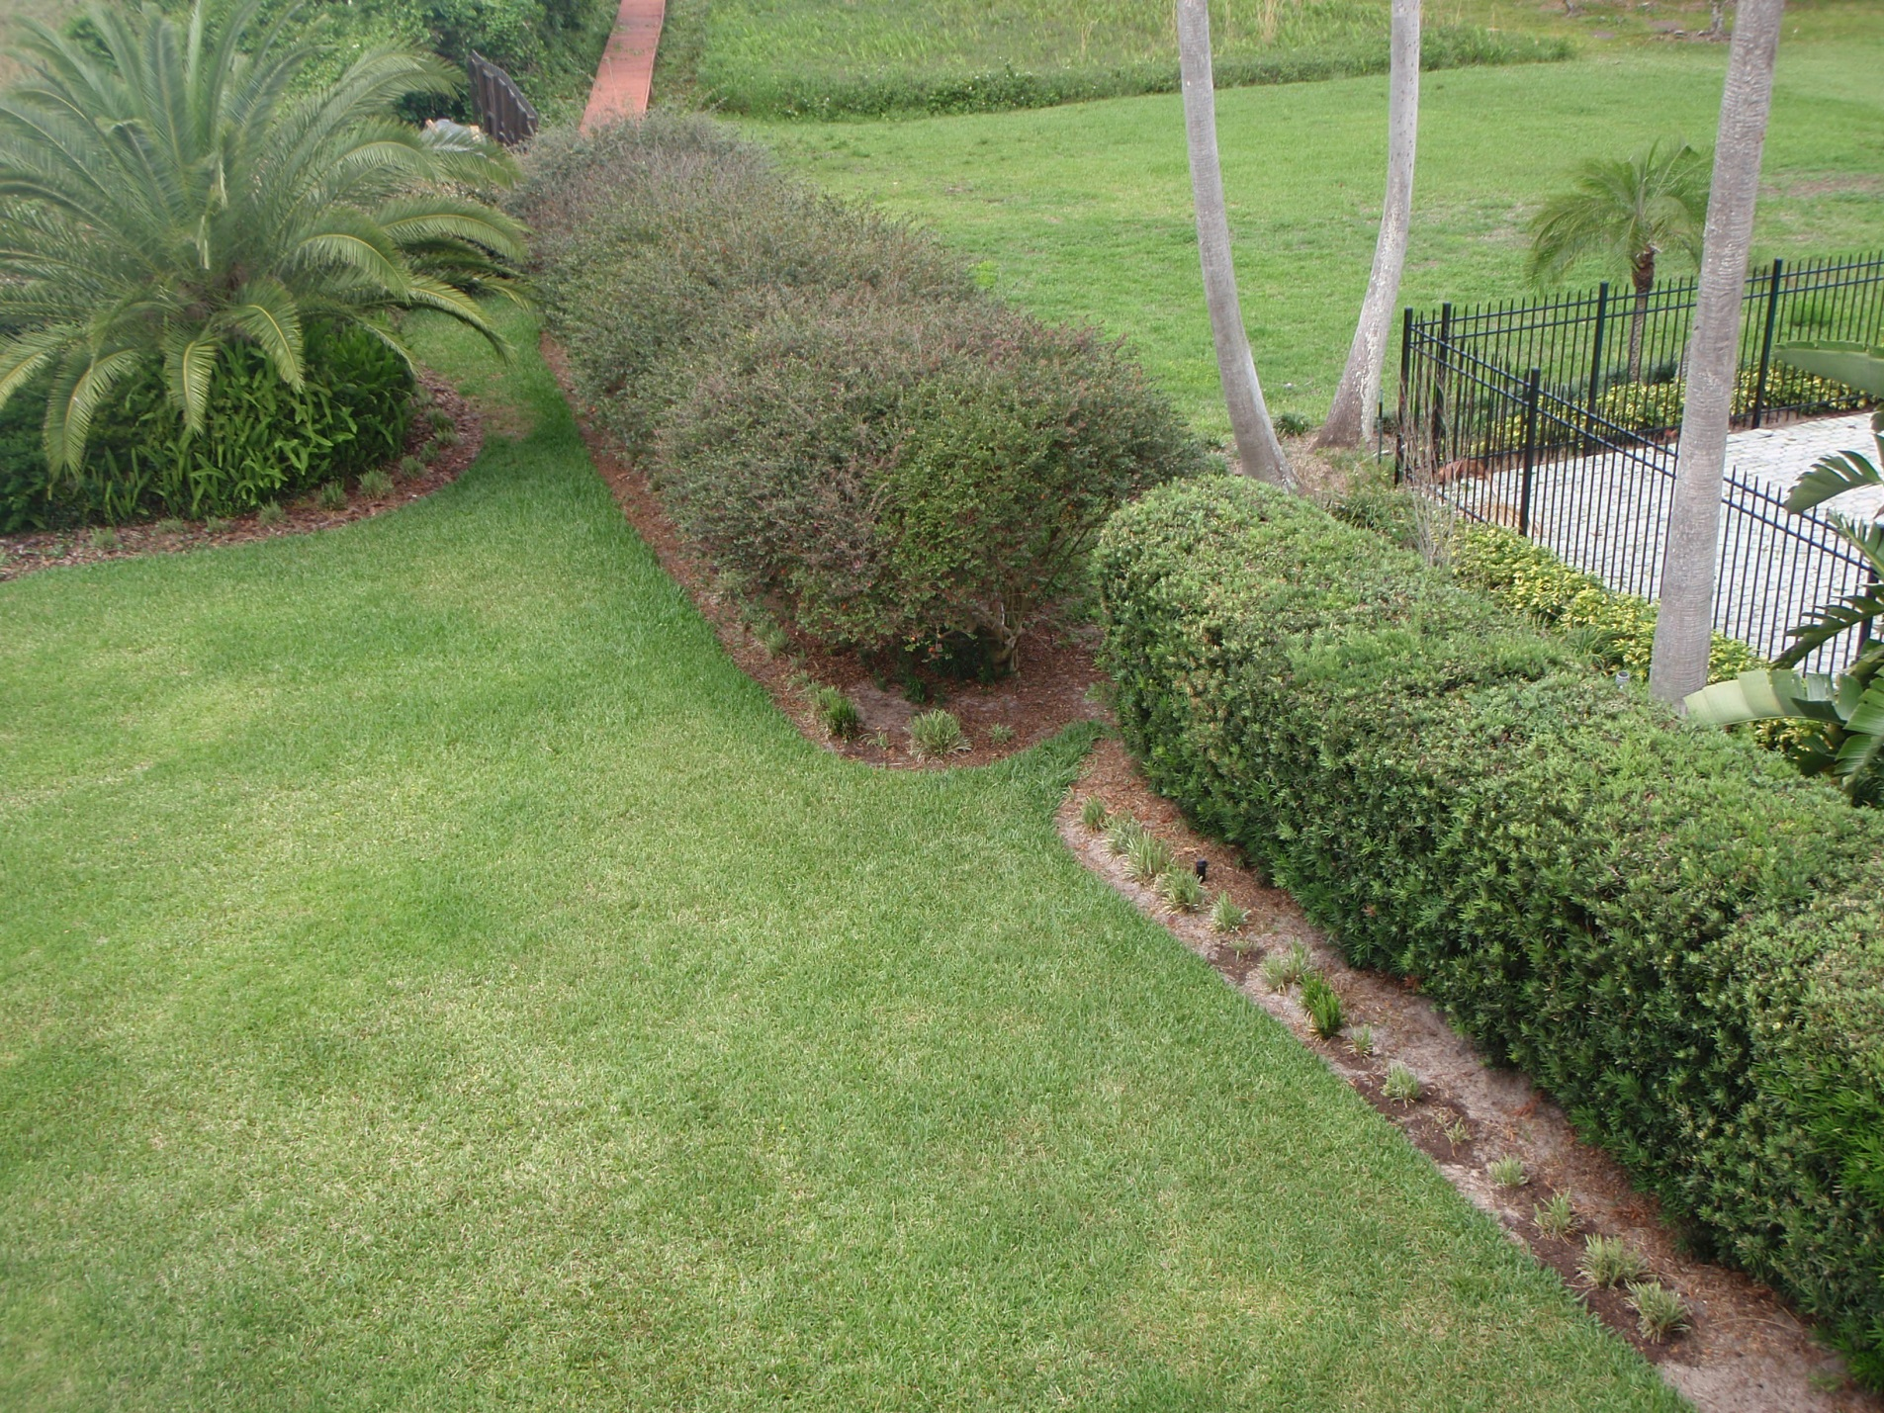

Slide 6
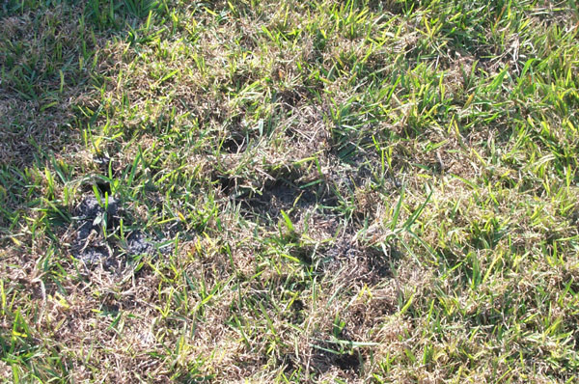
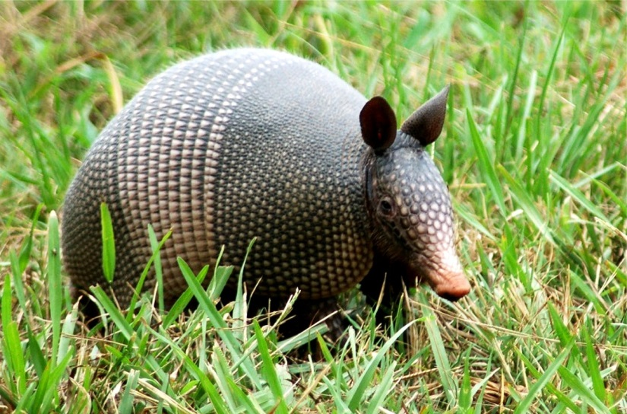
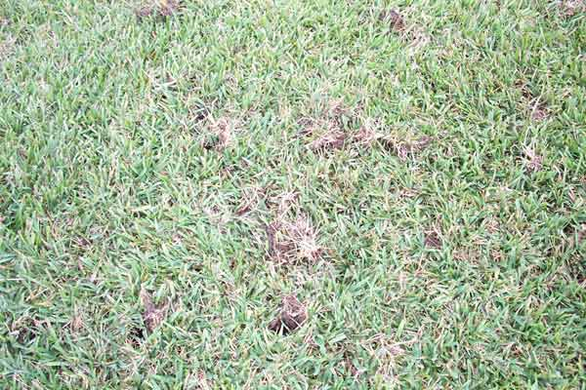
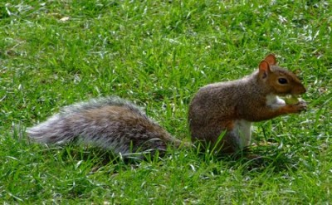
Grub Detector
Grass Destroyer

Slide 7
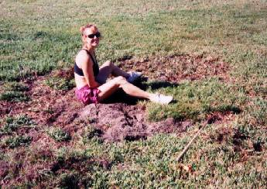
Cultural Control Mrs. Leppla

Slide 8
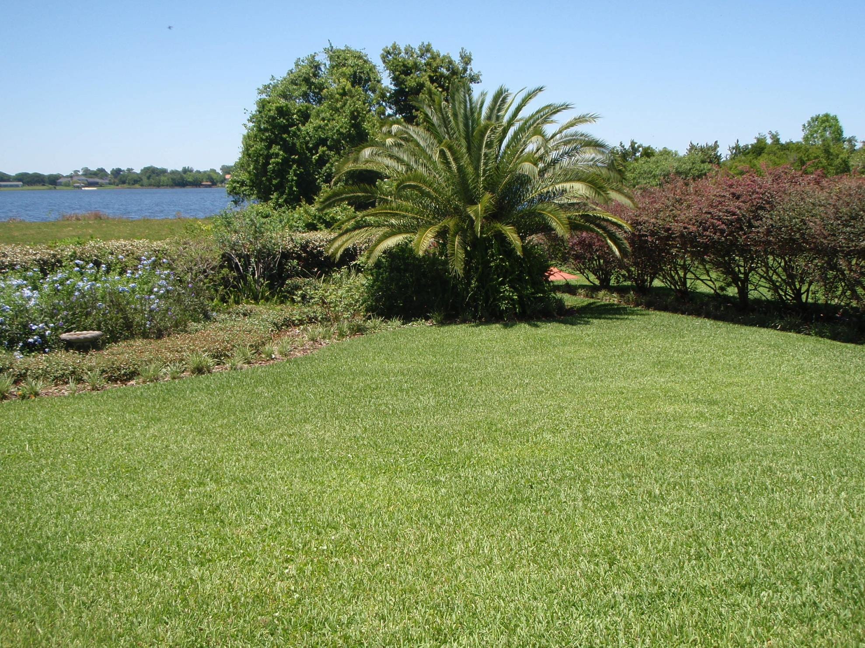

Slide 9
Right/Wrong
Wrong
Right
Threshold- waited too long, underestimated damage capability of chinch bugs
Expected some effective level of natural control
Depended on one insecticide that rapidly resulted in resistance
Tried several varieties of St. Augustinegrass
Increased the size of non-grass areas
Rotated insecticide chemistries and formulations
Improved coverage of sprinkling system

Slide 10
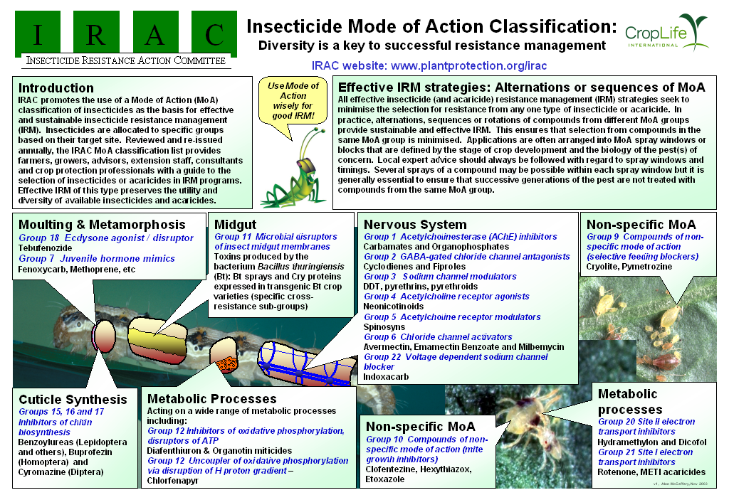

Slide 12
IRAC Insecticide Classification
Acetylcholine esterase inhibitor (Carbamates, Carbaryl; Organophosphates, Malathion)
GABA-gated chloride channel antagonists (Cyclodiene organochlorines, chlordane; Phenylpyrazoles, Fipronil)
Sodium channel modulators (Pyrethroids, Pyrethrins, Bifenthrin; DDT, Methoxychlor, DDT)
Nicotinic Acetylcholine receptor agonists (Neonicotinoids, Imidacloprid; Nicotine Nicotine; Sulfoxaflor, Sulfoxaflor
Nicotinic Acetylcholine receptor allosteric activators (Spinosyns, Spinosad)
Chloride channel activators (Avermectins, Abamectin; Milbemycins)
Juvenile hormone mimics (Juvenile hormone analogues, Methoprene, Fenoxycarb, Pyriproxyfen)
Miscellaneous nonspecific (multi-site) inhibitors (Alky halides, Methyl bromide, Chloropicrin, Sulfuryl fluoride)
Selective homopteran feeding blockers (Pymetrozine, Flonicamid)
Mite growth inhibitors (Clofentezine)
Microbial disruptor of insect midgut membranes (Bacillus thuringiensis and the insecticidal proteins they produce; Bacillus sphaericus)
Inhibitors of mitochondrial ATP synthase (Diafenthiuron; Organotin miticides, Azocyclotin)
Uncouplers of oxidative phosphorylation via disruption of proton gradient (Chlorfenapyr; Sulfuramid)
Nicotinic acetylcholine receptor channel blockers (Nereistoxin analogues, Bensultap)
Inhibitors of chitin biosynthesis, type 0 (Benzoylureas, Diflubenzuron)
Inhibitors of chitin biosynthesis, type 1 (Buprofezin)
Moulting disruptor, Dipteran (Cyromazine)
Ecdysone receptor agonists (Diacylhydrazines, Tebufenozide)
Octopaminergic receptor agonists (Amitraz)
Mitochondrial complex III electron transport inhibitors (Hydramethylnon)
Mitochondrial complex I electron transport inhibitors (METI acaricides and insecticides, Fenpyroximate, Rotenone)
Voltage-dependent sodium channel blockers (Indoxacarb)
Inhibitors of acetyl CoA carboxylase - Lipid synthesis, growth regulation (Tetronic and Tetramic acid derivatives, Spirotetramat)
Mitochondrial complex IV electron transport inhibitors (Zinc phosphide, Cyanide)
Mitochondrial complex II electron transport inhibitors (Beta-ketonitrile derivatives, Cyenopyrafen)
Vacant
Vacant
Ryanodine receptor modulators (Diamides, Chlorantraniliprole)
(UN) Compounds of unknown or uncertain mode of action (Azadirachtin, Azadirachtin; Cryolite, Cryolite)

Slide 13
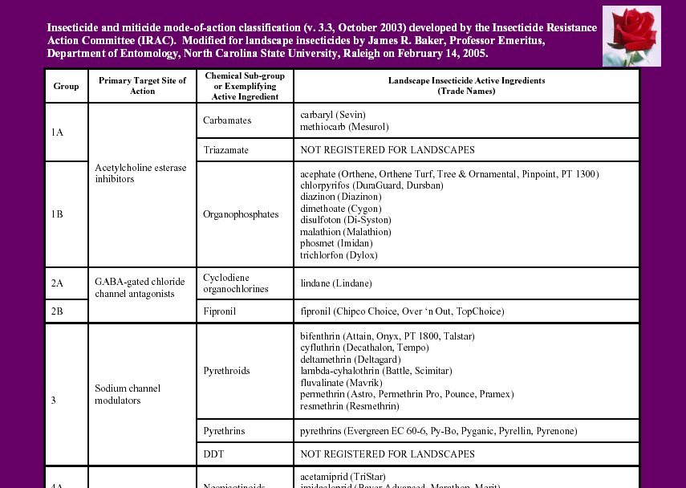

Slide 14
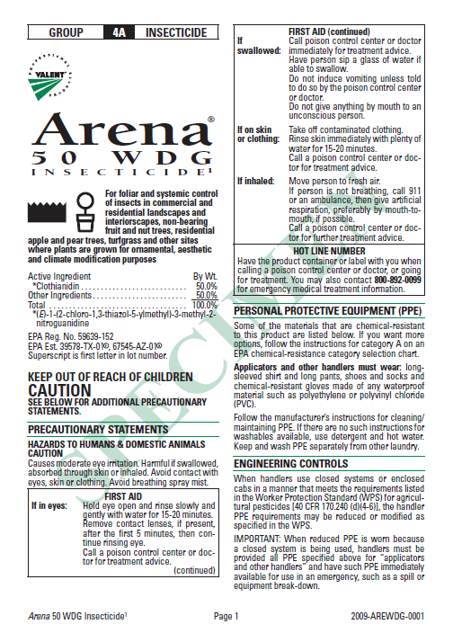
USER SAFETY RECOMMENDATIONS
Environmental Hazards
Directions for Use
AGRICULTURAL USE REQUIREMENTS
NON-AG USE REQUIREMENTS
LIMITED WARRANTY AND LIABILITY
RISKS OF USING THIS PRODUCT
RESISTANCE MANAGEMENT
RESTRICTIONS AND LIMITATIONS
Plant tolerance
Mixing instructions
Spray drift management
APPLICATION PROCEDURES
RESTRICTIONS AND LIMITATIONS
APPLICATION ON PLANTS FOR PESTS
STORAGE AND DISPOSAL

Slide 15
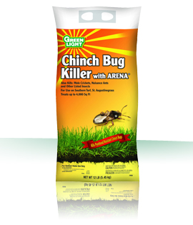
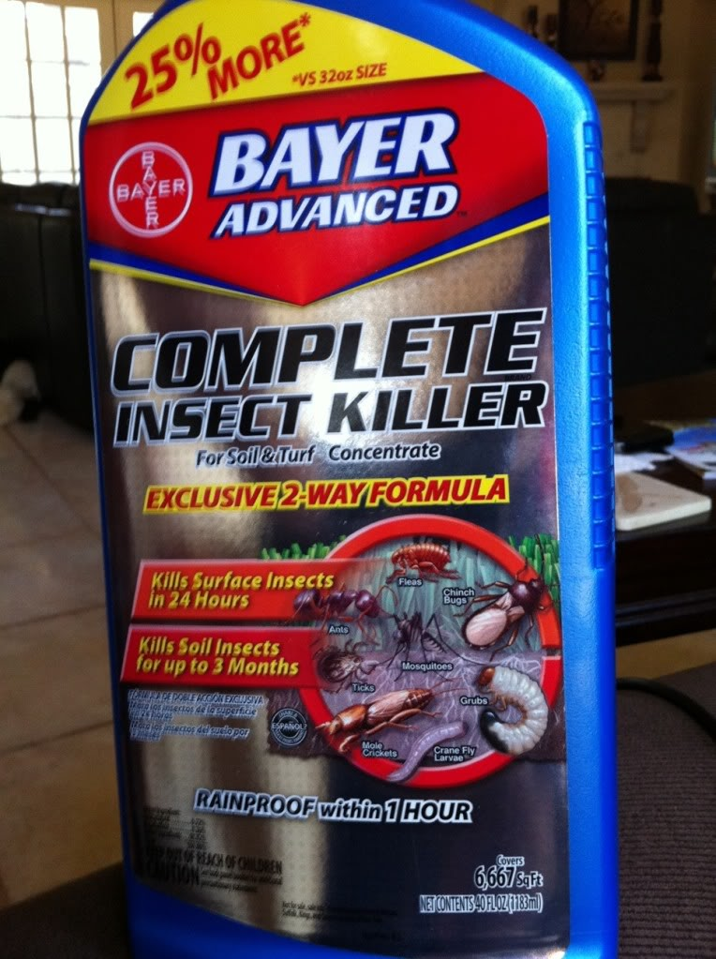

Slide 16
Insecticides Registered for Use on Southern Chinch Bug in Florida
Active ingredient | Chemical class | Retail/homeowner product examples | Professional product examples
Bifenthrin | Pyrethroid IRAC #3 | Scotts Lawn Pro Insect Control w/Fertilizer Scotts Turf Builder w/SummerGuard | Bifen XTS Onyx, OnyxPro Talstar EZ, PL granular Wisdom
Bifenthrin + clothianidin | Pyrethroid + neonicotinoid IRAC #3, 4A | None | Aloft
Bifenthrin + imidacloprid | Pyrethroid + neonicotinoid IRAC #3, 4A | None | Allectus
Bifenthrin + zeta-cypermethrin | Pyrethroid IRAC #3 | None | Talstar XTRA
Carbaryl | Carbamate IRAC #1 | Garden,Tech Sevin Gordons Liquid Dura-Spray | Sevin SL Sevin 80 WSP
Clothianidin | Neonicotinoid IRAC #4A | Arena 50 WDG | Arena 0.5 G
Cyfluthrin | Pyrethroid IRAC #3 | Bayer Advanced Power Force Multi-Insect Killer | Tempo
Cypermethrin | Pyrethroid IRAC #3 | None | Demon Max Demon WP
Deltamethrin | Pyrethroid IRAC #3 | Southern Ag Mole Cricket & Chinch Bug Lawn Insect Control | DeltaGard G DeltaGard T&O 5 SC
Imidacloprid | Neonicotinoid IRAC #4A | Bayer Advanced Season Long Grub Control | Merit
Lambda-cyhalothrin | Pyrethroid IRAC #3 | Spectracide Triazicide Once & Done Insect Killer | Demand CS Demand G Scimitar CS
Permethrin | Pyrethroid IRAC #3 | Spectracide Bug Stop Insect Control Granules | Astro Permethrin Pro Termite-Turf Ornamental
Thiamethoxam | Neonicotinoid IRAC #4A | None | Meridian 0.33G, 25WG
Trichlorfon | Organphosphate IRAC #1 | Bayer Advanced 24-Hour Grub Control | Dylox 80 T&O

Slide 17
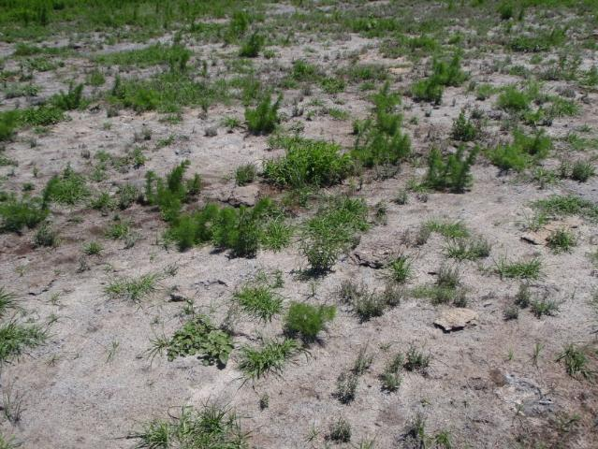
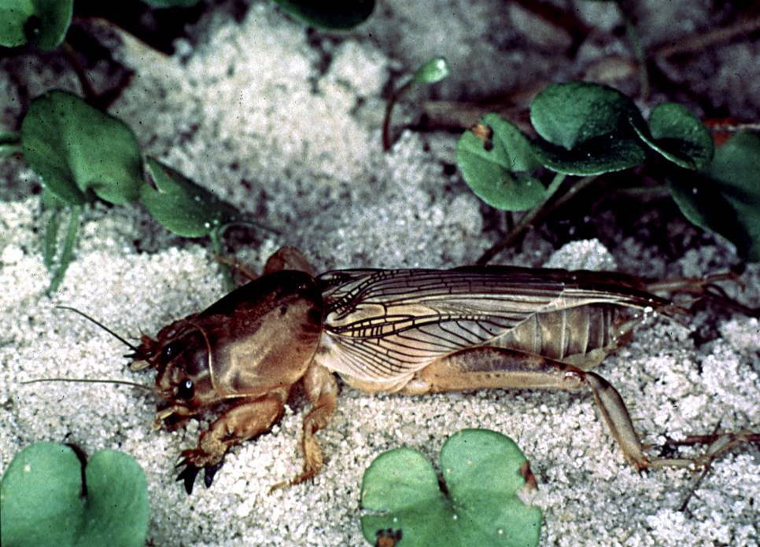
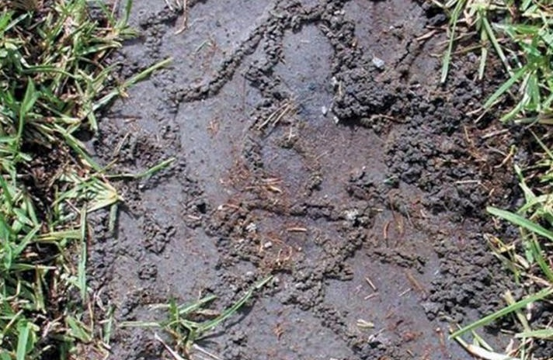
Alien Invasive Mole Crickets
(Orthoptera: Gryllotalpidae)
Shortwinged mole cricket, Scapteriscus abbreviatus
Southern mole cricket Scapteriscus borellii
Tawny mole cricket Scapteriscus vicinus

Slide 18
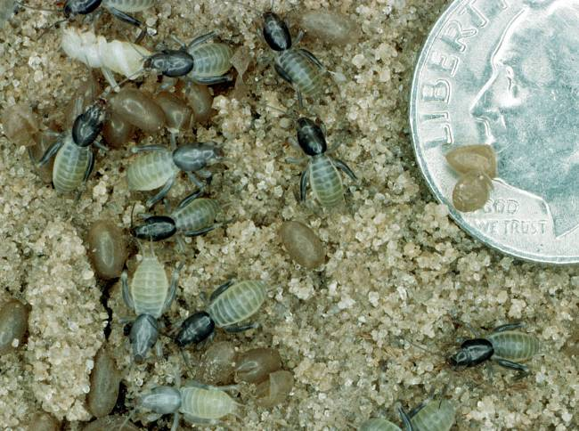
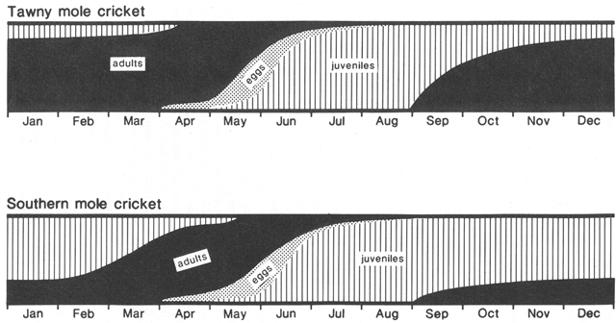
Seasonal Distribution of Mole Cricket Stages

Slide 19
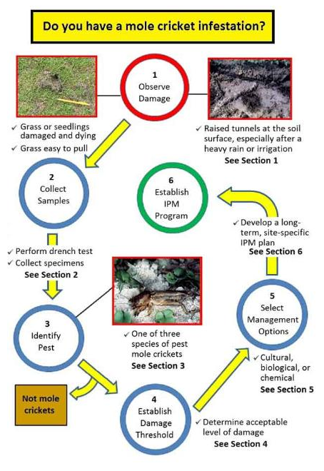
EDIS IPM-206: Mole Cricket IPM Guide for Florida

Slide 20
Mole Cricket IPM Guide for Florida
Damage
Sampling
Diagnosis (identification)
Damage threshold (action threshold)
Management Options (cultural, biological, chemical)
Long-term mitigation (prevention, sustainable IPM strategy)

Slide 21
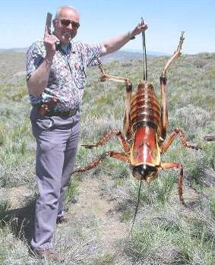
What is IPM?
It coordinates the use of pest biology, environmental information, and available technology to prevent unacceptable levels of pest damage by the most economical means, while posing the least possible risk to people, property, resources, and the environment.

Slide 22
IPM System
Pest outbreaks & disease epidemics
Environmental contamination
Human health hazards
Pest mgmt. costs
Reduce risks
INCREASE…
Reliability
Sustainability
Chem
Biological Control
Cultural Methods

Slide 23
Complete IPM Program
Biological knowledge
Monitoring and inspection
Act to control pests when necessary
Choose least-risk options
Long-term, preventative practices
Evaluation and records
Pesticide management
Continual improvement

Slide 24

IPM Florida provides statewide, interdisciplinary and inter-unit coordination and assistance for UF/IFAS integrated pest management research Extension and education faculty
http://ipm.ifas.ufl.edu

Slide 25
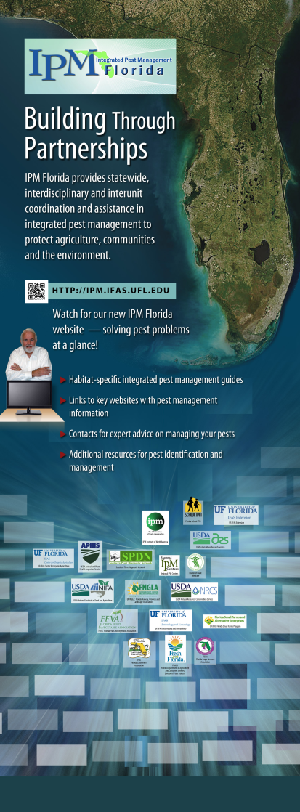
Direct Access to IPM Information
Habitat-specific IPM guides, fact sheets.
EDIS articles, Featured Creatures, etc.
Links to specialized websites with IPM
management information specific to
a crop or situation.
Key contacts for expert advice on
managing pests.
Additional resources for pest
identification and management,
e.g., diagnostic services.

Slide 26
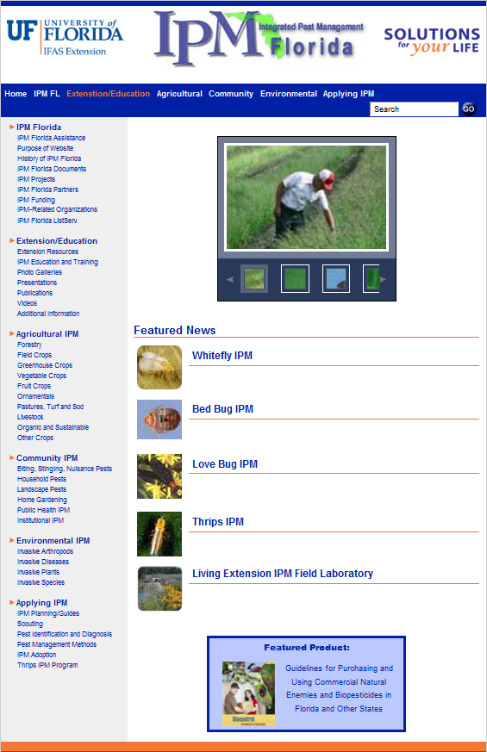
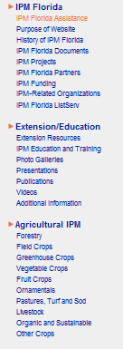
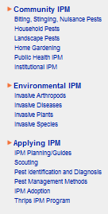

Slide 27


http://www.floridalivestockagents.org
http://ipm.ifas.ufl.edu

Slide 28


Extension Diagnostic Services
What can the Gainesville campus diagnostic laboratories do for a master gardener volunteer client?
Anthony Camerino
Citrus County Extension
Master Gardener Volunteer Coordinator
IPM Florida Presentation Number 18

Slide 29
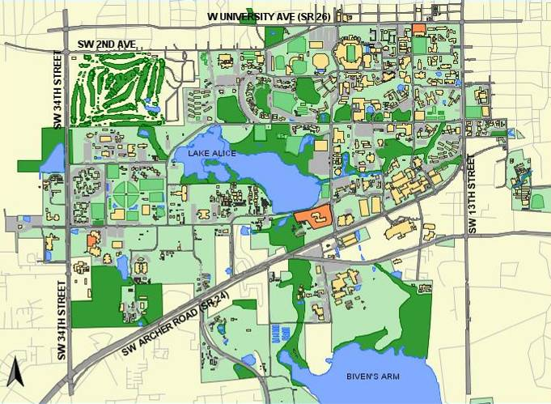
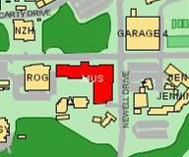
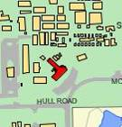
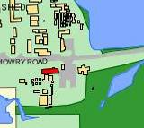
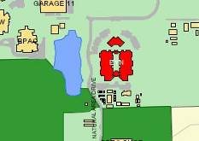
Plant Identification
Extension Soil Testing Lab
Plant Disease Clinic & Nematode Assay Lab
Insect Identification Lab

Slide 30
How to Send a Sample to Gainesville and Receive the Results?
Master Gardener Volunteer Plant Clinic/Phone Room
Maybe if I put enough stuff in this box, put a stamp on it, and send it to Gainesville someone will tell me what’s wrong with my plant?
I can’t diagnosis your problem here, but I can get your sample to the right lab for an accurate and timely diagnosis.

Slide 31
Scotts Miracle-Gro Company Fined $12.5 Million in February 2012
pled guilty to “illegally applying insecticides to its wild bird food products that are toxic to birds, falsifying pesticide registration documents, distributing pesticides with misleading and unapproved labels and distributing unregistered pesticides”
The insecticides added to Scotts wild bird food products were Actellic 5E and Storcide II

Slide 32
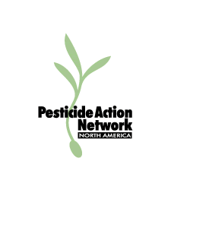
Pesticide Information
UF/IFAS Pesticide Information Office
CDMS- ChemSearch
CDMS- http://www.cdms.net/
LabelsMsds/LMDefault.aspx
EPA- http://www.epa.gov/
opp00001/regulating/
registering/data_sources.htm
Extension Pesticide Applicator Training

Slide 33
FDACS, Division of Agricultural Environmental Services, Bureau of Pesticides- Online Pesticide Registration System
Florida Pesticide Product Data
15584 Products Registered
Select and Submit Search Option
Active Ingredient | EPA Registration Number
Site of Application | Product Name
Pest to be Controlled | Company Name
http://www.flpesticide.us/

Slide 34
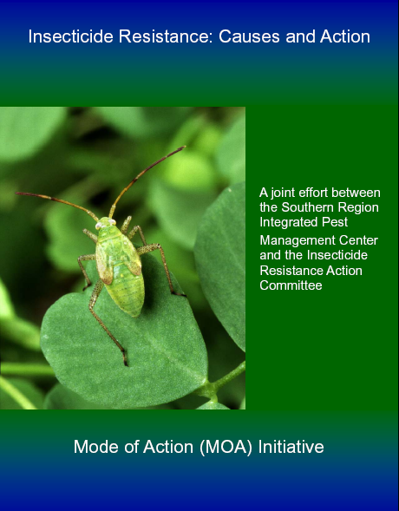

Pesticide Resistance
Steve Toth
Southern Region IPM Center
Tom Anderson
FMC Corporation
Fred Fishel
UF/IFAS
http://utahpests.usu.edu/ipm/files/uploads/pptdocs/05sh-pesticides-new.pdf
http://miami-dade.ifas.ufl.edu/pdfs/pesticide_applicator/Insecticide%20Resistance.pdf

Slide 35
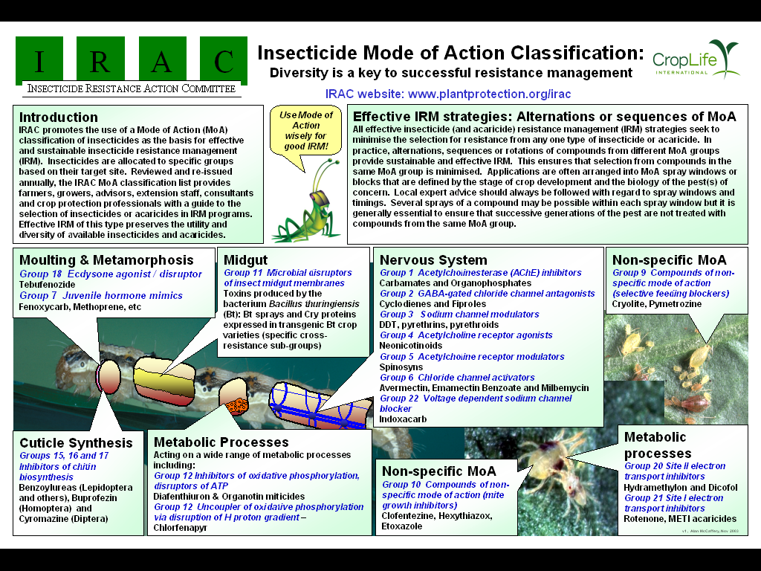

Slide 36

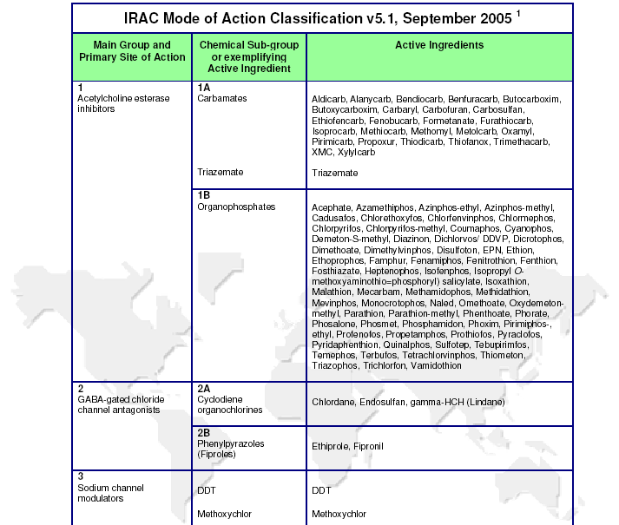

Slide 37
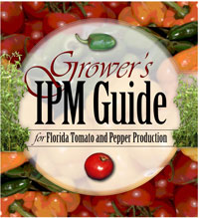
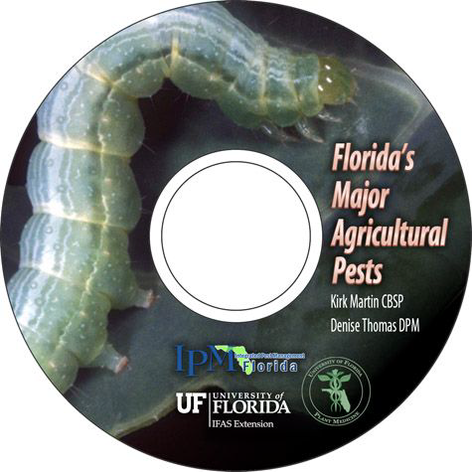
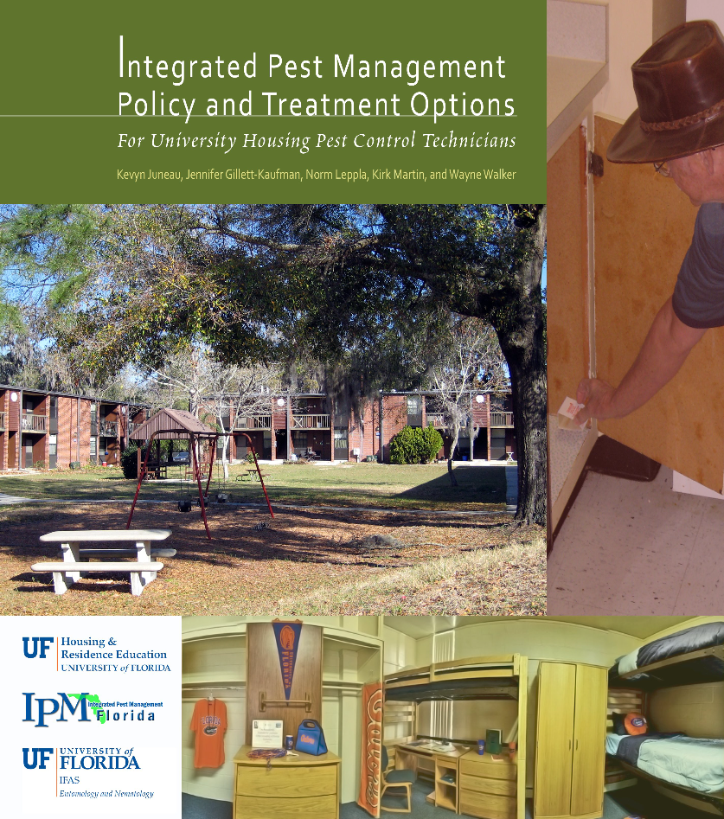
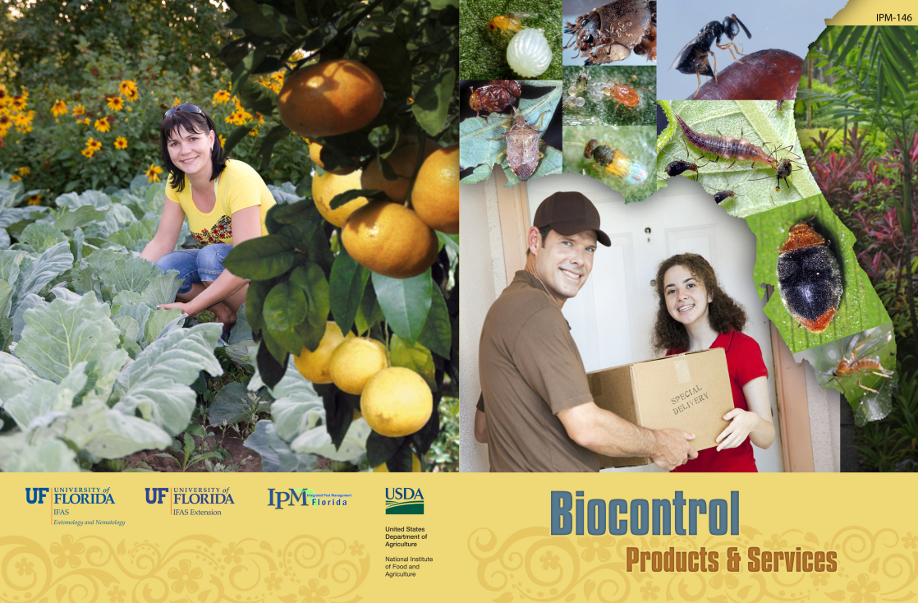
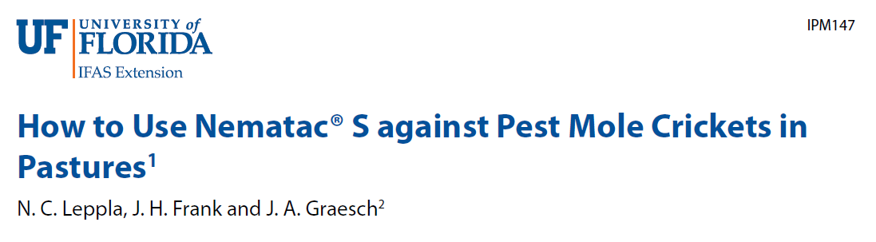
Extension Guides

Slide 38
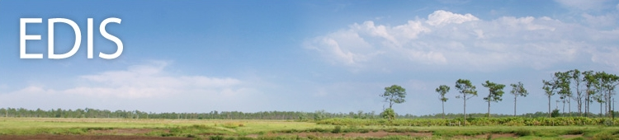
Electronic Data Information Source (EDIS)
The EDIS website is a comprehensive, single-source repository of all current UF/IFAS numbered peer-reviewed publications (about 7,500).
http://edis.ifas.ufl.edu/

Slide 39
Electronic Data Information Source (EDIS)
Agriculture
Community Development
Environment
Families & Consumers
4H Youth development
Lawn & Garden
Aquaculture
Crops
Livestock
Nursery & GH
Organic farming
Agricultural safety
Small farms
Turf & sod

Slide 40






Featured Creatures provides in-depth profiles of insects, nematodes, arachnids and other organisms. The site is a cooperative venture of the University of Florida's Department of Entomology and Nematology and the Florida Department of Agriculture and Consumer Services' Division of Plant Industry. All articles are official publications of the University of Florida's Institute of Food and Agricultural Sciences.
 |  | or

Slide 41
